Slide 1
Chongqing University of Technology
ATAI
Advanced Technique of Artificial Intelligence
Chongqing University of Technology
AAAI_2021
AAAI_2020
Github:None
Hongyang Song

Slide 2
Outline
Motivation
Approach
Experiments
Conclusion

Slide 3
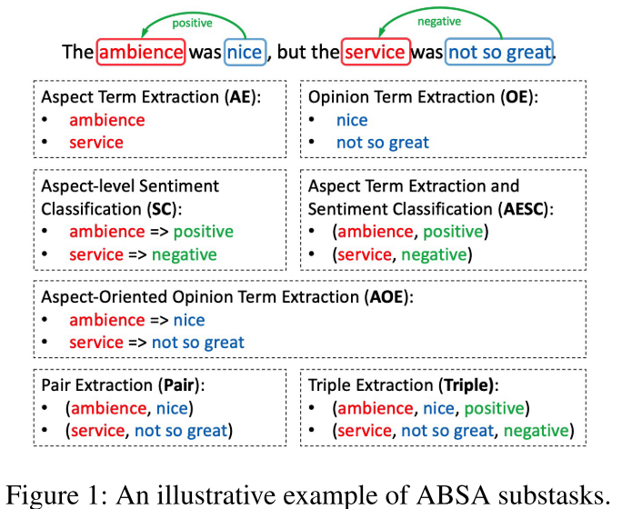
Motivation
Notes:
AE:方面词提取, OE:观点词提取, SC:情感分类, AESC:方面词提取并分类, AOE:基于方面词的情感分类
Pair:方面词和观点次提取, Triple: 方面词,观点次提取并分类
Ambience: 环境

Slide 4
AAAI_2020

Slide 5
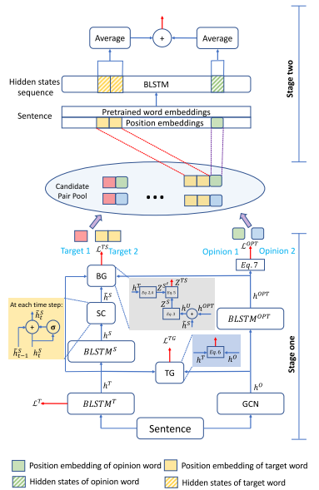
Approach
Notes:
B denotes begin(开始), I denotes inside(内部), E denotes end(结束), S denotes single(单独) and O denotes outside(外部)

Slide 6
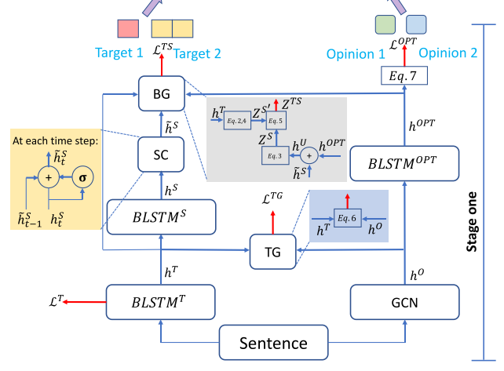
Approach
Notes:
Sentiment Consistency (SC) 情感一致性
第一个双向LSTM是预测BIO,辅助TG(target guidance)和BG(boundary guidance)
Sentiment Consistency (SC)
W_tr是一个转换矩阵

Slide 7
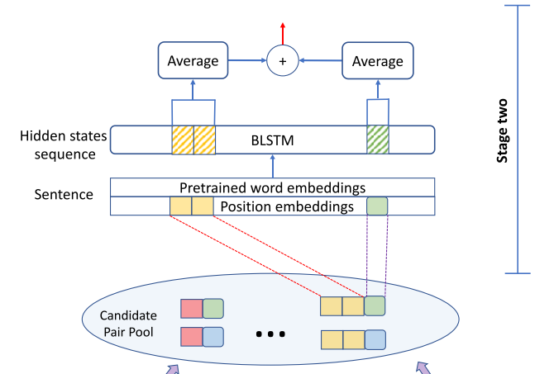
Approach

Slide 8
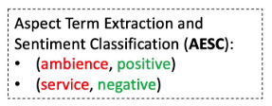
Experiments

Slide 9
Experiments

Slide 10
Experiments

Slide 11
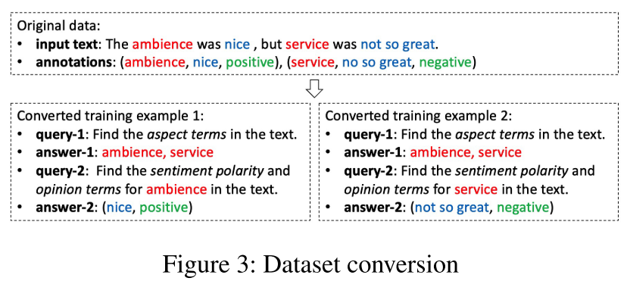
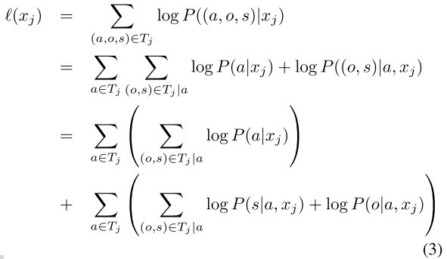
AAAI_2021

Slide 12
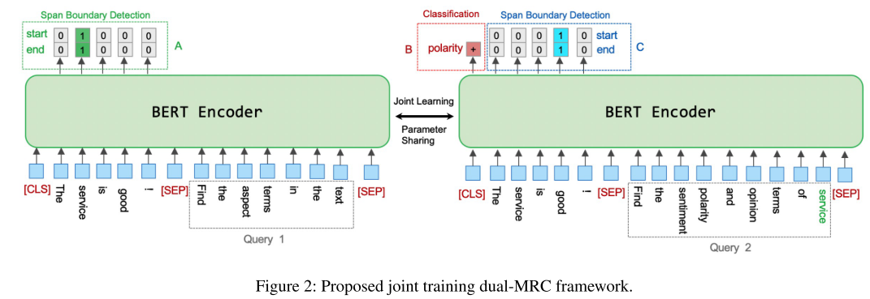
Approach

Slide 13
Approach

Slide 14
Experiments
Notes:
AE: 方面词提取, OE:情感词提取, SC:情感分类, AESC:方面词提取并分类

Slide 15
Experiments
Notes:
AOE:基于方面词的情感词提取

Slide 16
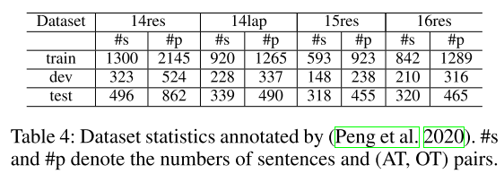
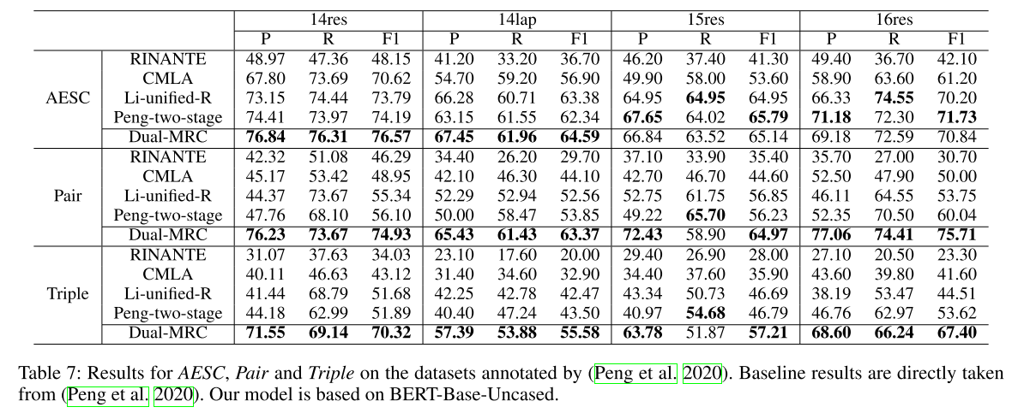
Experiments
Notes:
AESC:方面词提取并分类

Slide 17
Experiments

Slide 18
Experiments

Slide 19
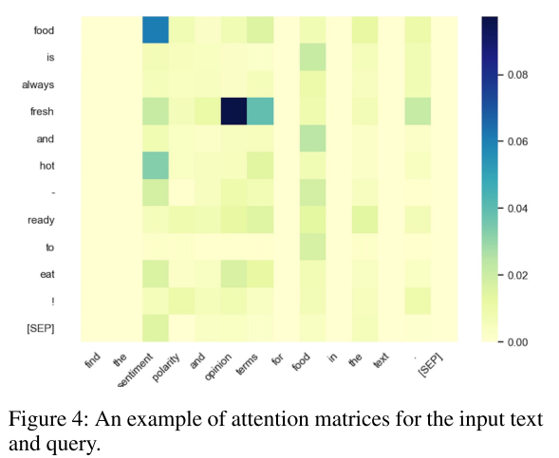
Experiments

Slide 20
Thanks

